Slide 1




TEAM ID COLLAGE NAME TEAM LEADER
TEAM MEMBERS
:- Team_3949
:- PARUL UNIVERSITY
:- PRERNA SHEKHWAT
:- PRIYANSH KANOJE
VAIBHAV AMRIT

Slide 2
Abstract
Diagnosis360 is an intelligent healthcare system that utilizes machine learning algorithms to predict the likelihood of a patient developing various diseases based on their medical history, lifestyle, and other relevant factors. The system takes in data from various sources such as electronic health records, medical databases, and patient self-reports to create a comprehensive profile of the patient.
The system uses various machine learning models to predict the probability of a patient developing multiple diseases such as diabetes, Heart Disease, Breast Cancer disease, and more. These predictions are based on various features such as age, gender, family history, lifestyle factors such as smoking, alcohol consumption, exercise habits, and more.

Slide 3
PROBLEM STATEMENT
Traditional diagnostic methods can be time-consuming and may not always provide accurate results, leading to delays in treatment and potentially negative health outcomes for patients
The need for accurate and efficient diagnosis of multiple diseases in patients.
with the growing prevalence of chronic diseases and complex medical conditions, healthcare professionals are faced with a growing burden of identifying and treating multiple diseases in patients. This can lead to increased workload and stress on healthcare systems, as well as a higher risk of misdiagnosis or missed diagnoses.

Slide 4
PROJECT OVERVIEW
Multiple disease prediction system [Diagnosis360] is a project that aims to predict various diseases based on the input symptoms of the patient. In this project, several machine learning algorithms have been implemented to predict the disease accurately. The algorithms used in this project include Decision Tree, SVM, Logistic Regression.
1) Decision Tree Algorithm for Symptom Checker
2) Support Vector Machine for Diabetes and Parkinson's Disease Prediction
3) Heart Disease Prediction from Logistic Regression
4) Breast Cancer Prediction using Neural Network

Slide 5
WHO ARE THE END USER?
Patients can use this system to self-assess their health and receive recommendations for further medical evaluation or treatment.
Healthcare providers such as doctors, nurses, and other medical professionals can use this system to help diagnose and treat patients.
Researchers can use this system to analyze data and identify patterns or correlations between diseases and various risk factors.

Slide 6
THE WOW FACTOR
Its ability to leverage advanced technology to improve the accuracy and efficiency of disease diagnosis and treatment, ultimately leading to better patient outcomes and a healthier population.
Analyze large amounts of patient data and use advanced machine learning algorithms to accurately predict the likelihood of multiple diseases in a single patient.

Slide 7
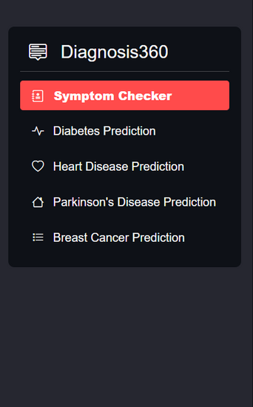
USER INTERFACE
HOME PAGE:

Slide 8
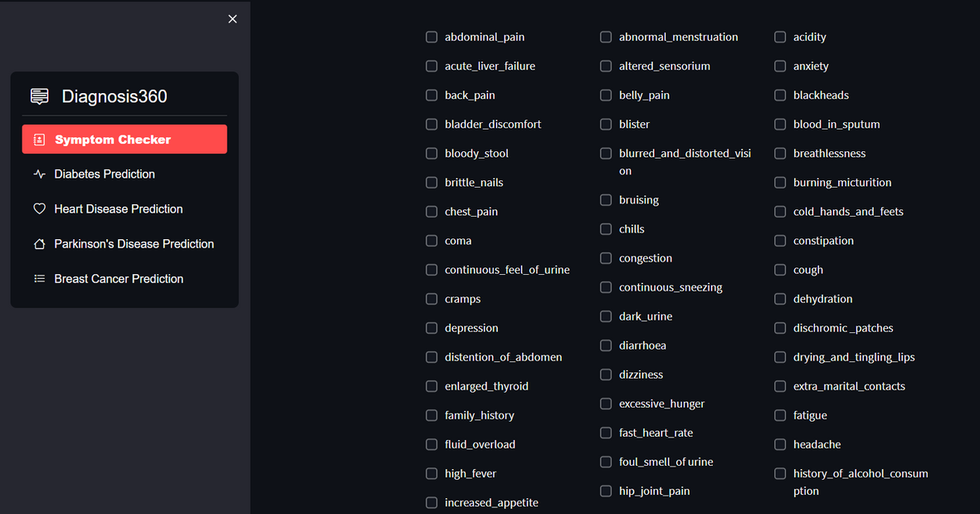
SYMPTOM CHECKER:

Slide 9
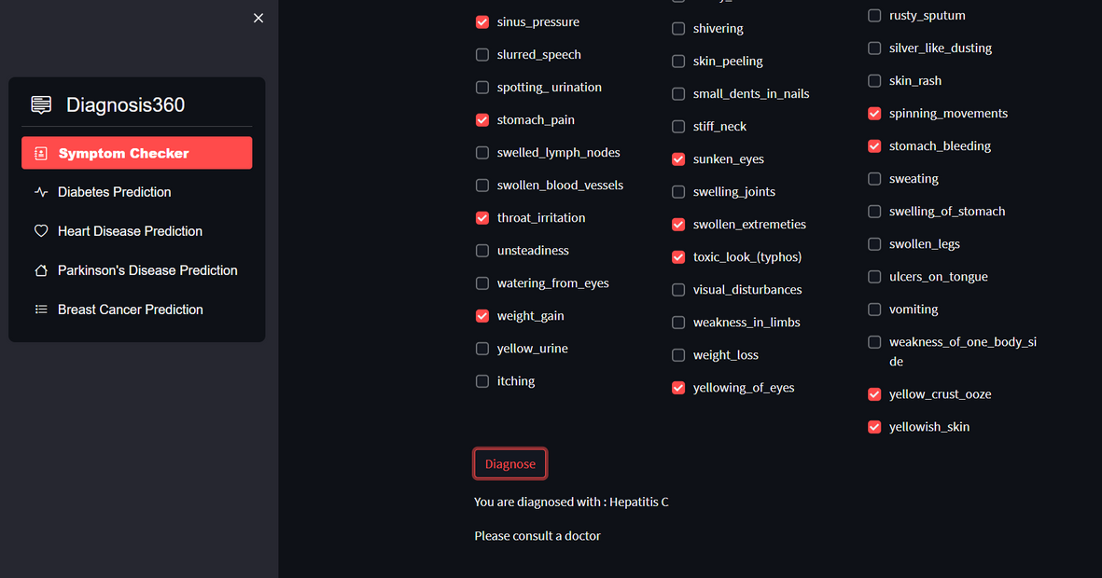
SYMPTOM CHECKER RESULT:

Slide 10
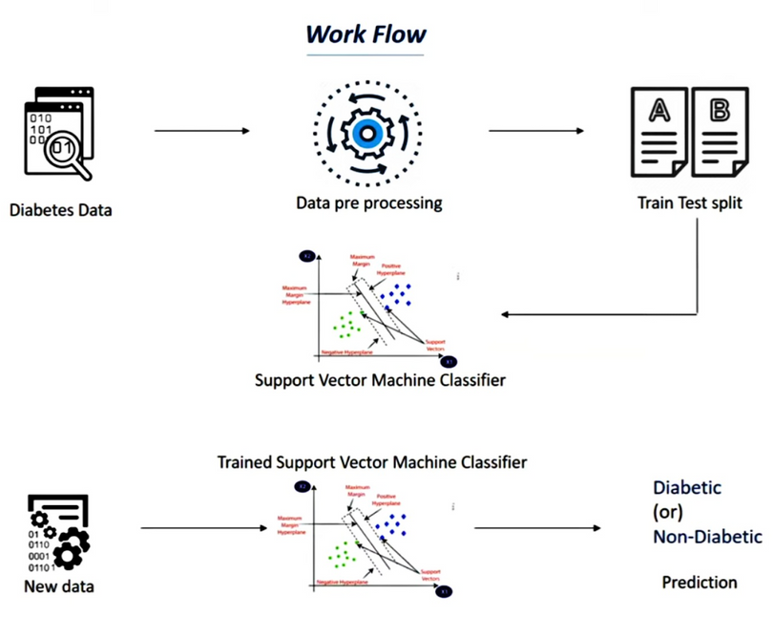
BLOCK DIAGRAM FOR DIABETES PREDICTION

Slide 11
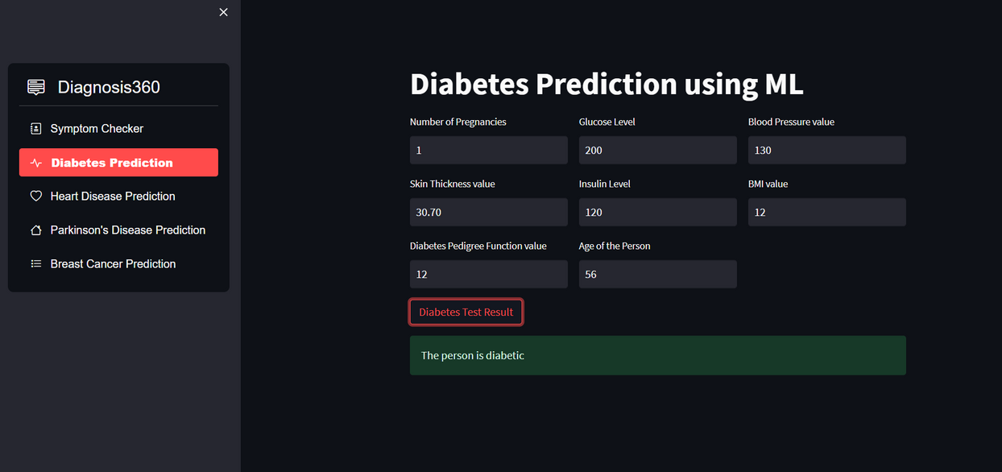
DIABETES PREDICTION:

Slide 12
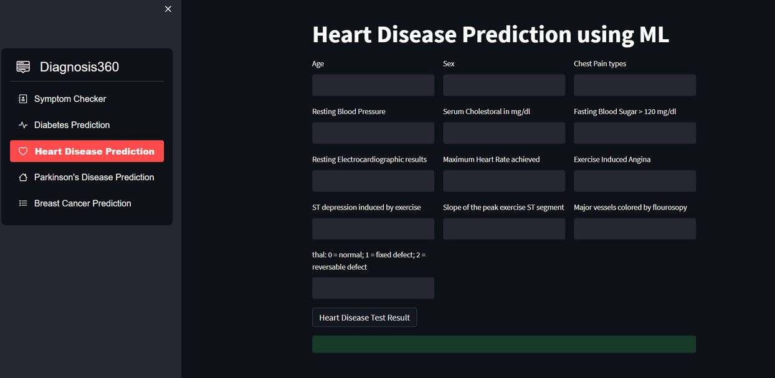
HEART DISEASE PREDICTION:

Slide 13
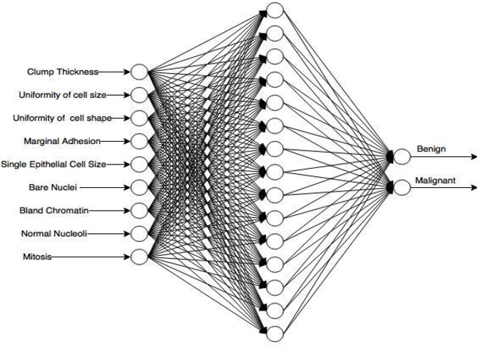
BLOCK DIAGRAM FOR BREAST CANCER PREDICTION

Slide 14
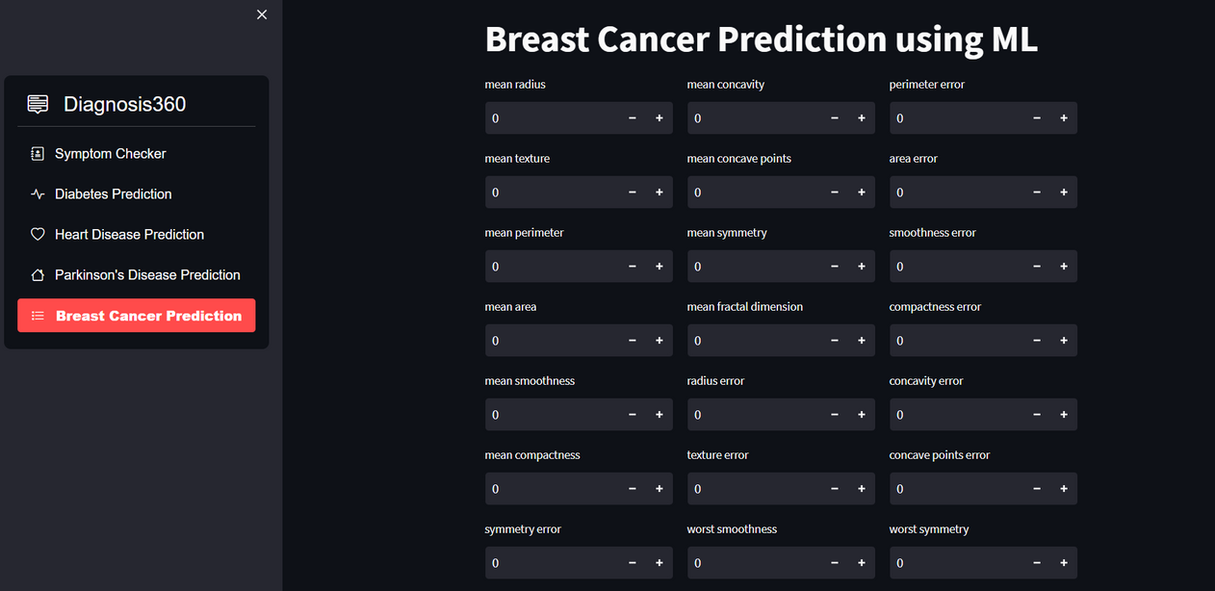
BREAST CANCER PREDICTION:

Slide 15
Conclusion
In this project, multiple machine learning algorithms were implemented to predict various diseases based on input symptoms. Decision Tree algorithm was used to diagnose diseases based on input symptoms. SVM was used to predict diabetes, breast cancer, and Parkinson's disease, and Logistic Regression was used to predict heart disease. The accuracy of each algorithm was dependent on the quality and size of the dataset used to train the model. Overall, this project has shown the potential of machine learning algorithms in predicting various diseases accurately.

Slide 16



MEET OUR TEAM
PRIYANSH KANOJE
PRERNA SHEKHWAT
VAIBHAV AMRIT

